Slide 1

“Academic insights from modelling and Danish experience”
Henrik Lund, Professor in Energy Planning
Aalborg University, Denmark

Slide 2
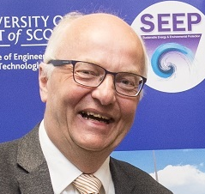

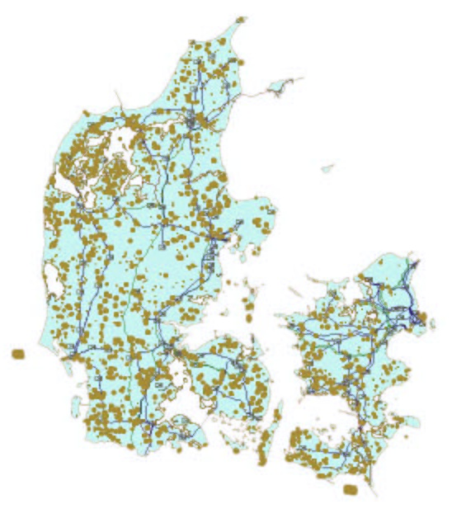
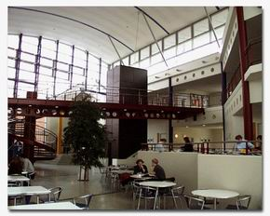


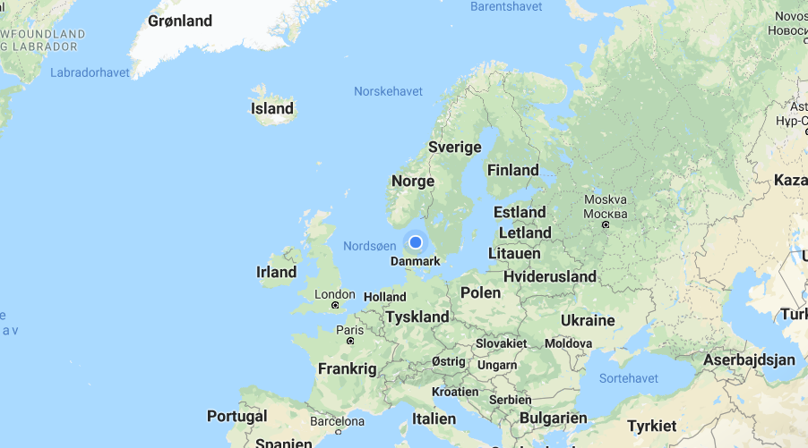
Henrik Lund, Aalborg University, Denmark
Jutland/Denmark:
Approx. 50% wind power
High share of the world’s offshore power
30-50% of electricity supplied by CHP
>50% District Heating
> 40% Biogas in the natural gas supply

Slide 3
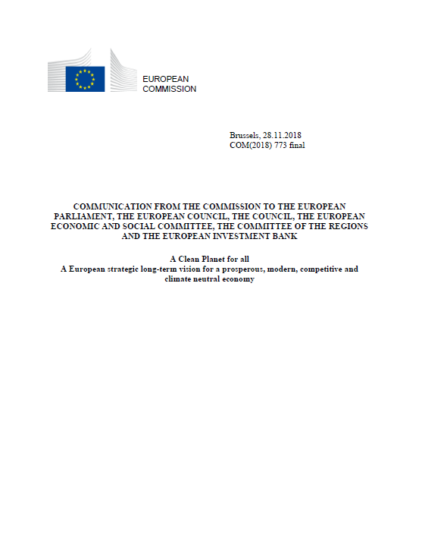
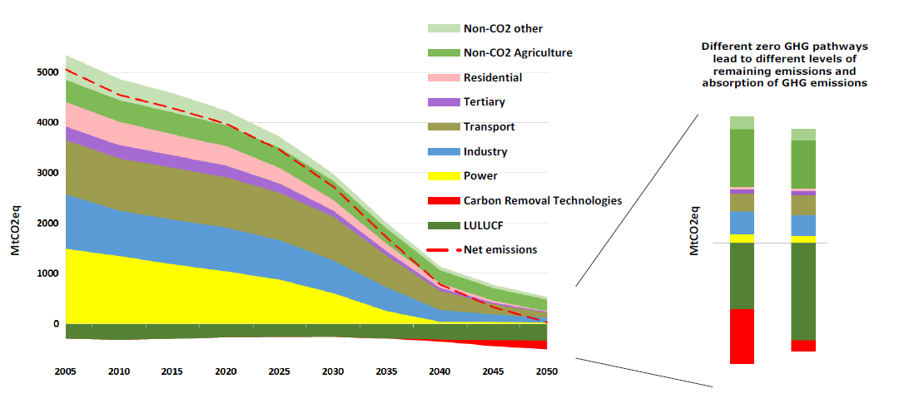
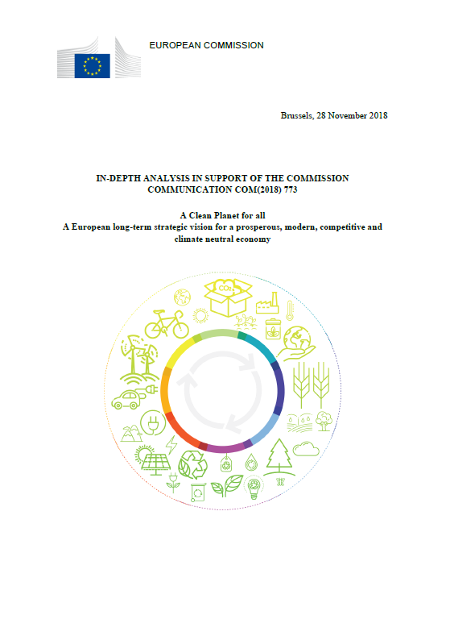
A Clean Planet for all
A European long-term strategic vision for a prosperous, modern, competitive and climate neutral economy
Climate Neutral

Slide 4
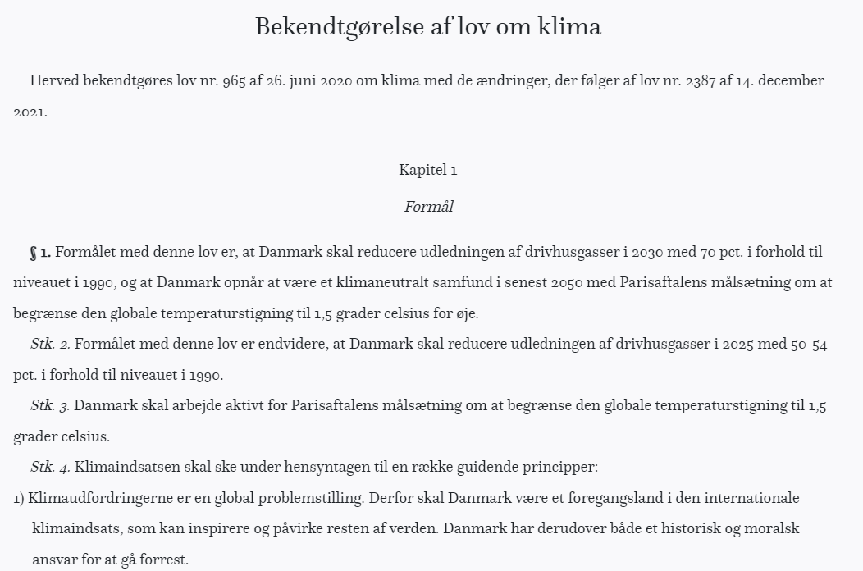

Danish Climate Policy Targets
Danish Climate Act June 2020 | Reduction in Climate gasses | Danmark will reduce climate gas emissions by 70 pct. in 2030 compared to1990
 | Climate Neutral | Danmark will at the latest in 2050 achieve net zero emissions
Government agreement, December 2022:
The Government will implement Climate Neural in 2045, and
Introduce at new target of 110 pct. reduction in 2050 compared to 1990.

Slide 5


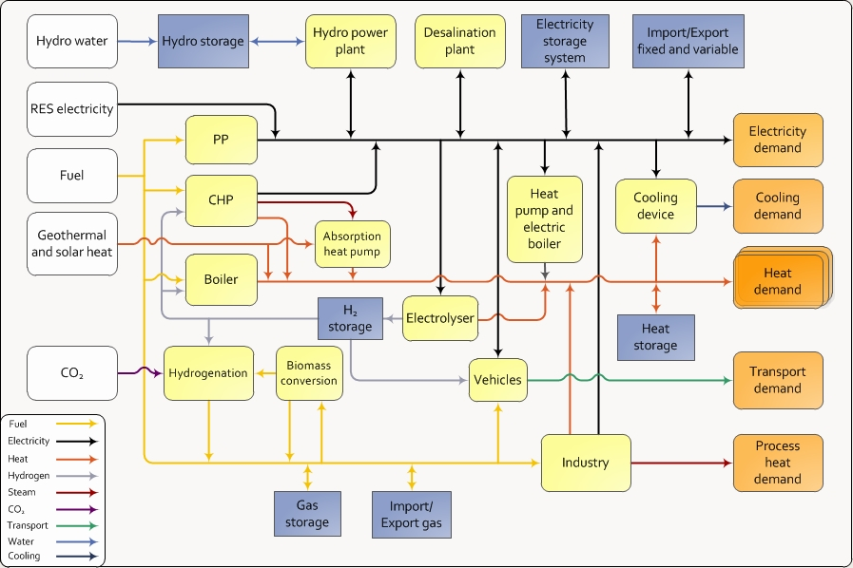

Renewable Energy Systems
2. Edition in 2014 New Chapter on Smart Energy Systems and Infrastructures
3. Edition in 2024 New Chapter on Carbon Neutral Societies
1. Edition in 2010

Slide 6
Primary Energy Consumption in Denmark
Successes:
Building improvements
District heating
Wind turbines
System level energy efficiency
Biggest culprits:
Transport
Too little energy efficiency
Our self-sufficiency rate

Slide 7
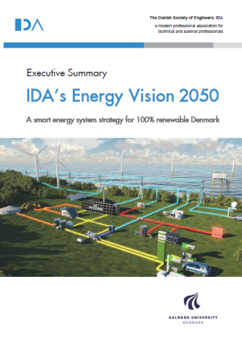
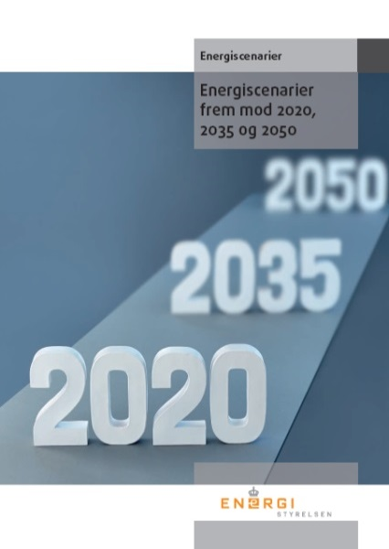

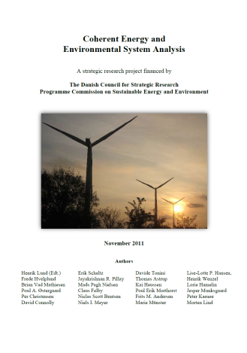
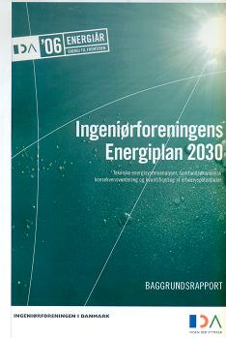

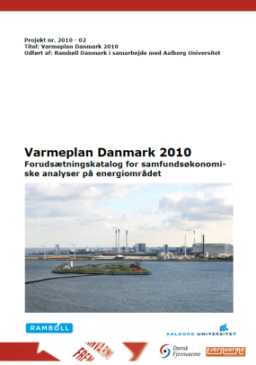

100% Renewable Energy 2050 Or a Climate Neutral Economy
…… but how…???!!

Slide 8
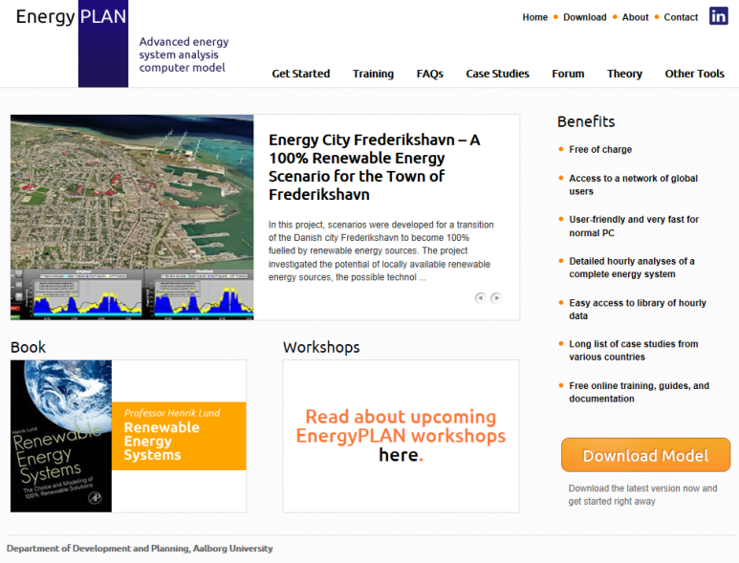
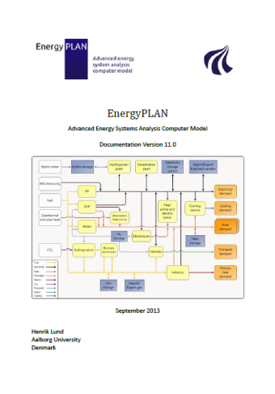
www.EnergyPLAN.eu
nergi System Analyse Model

Slide 9
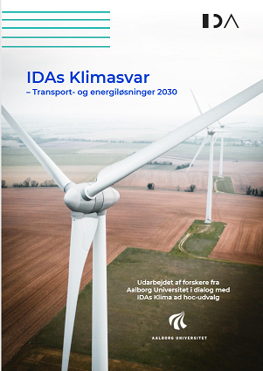
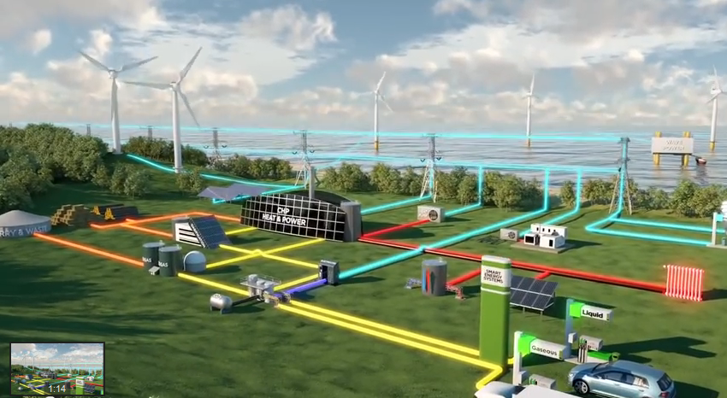

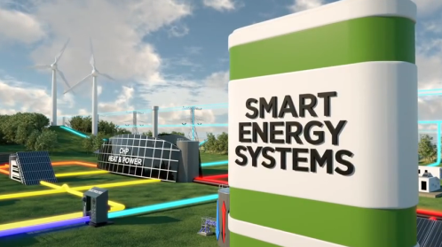
A Holistic Smart Energy Systems Approach

Slide 10
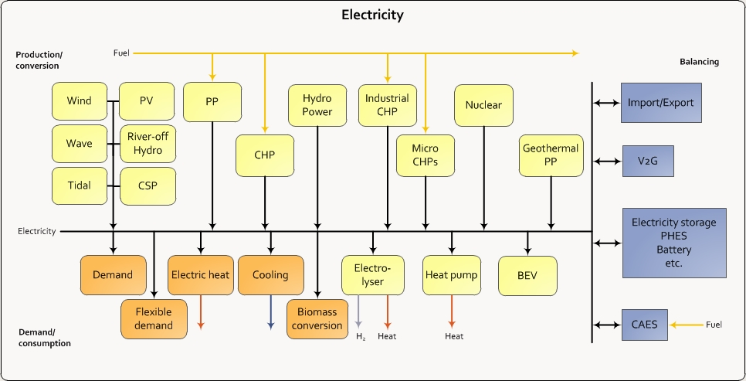
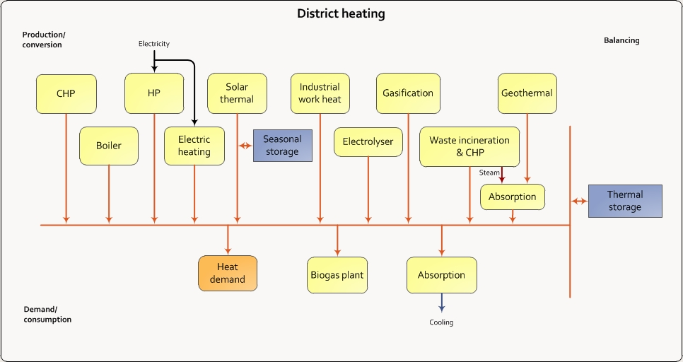
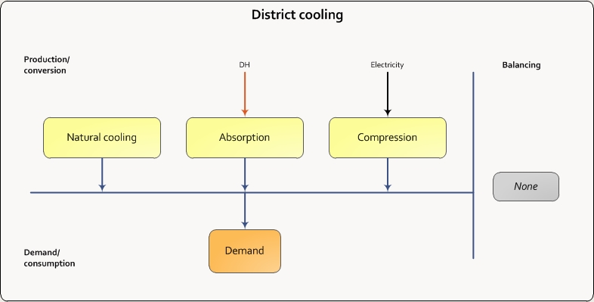
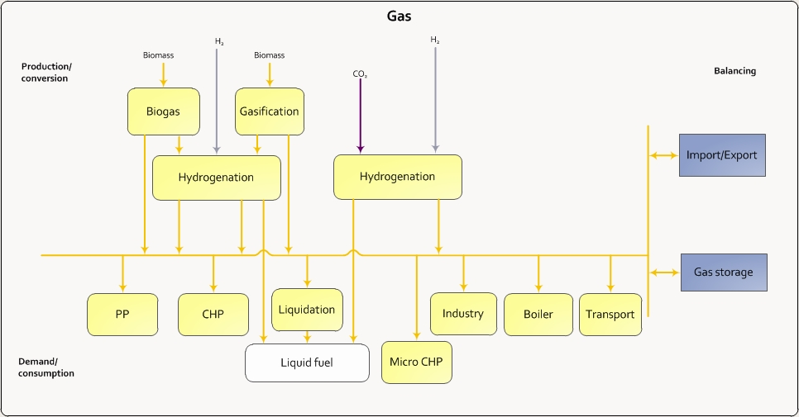
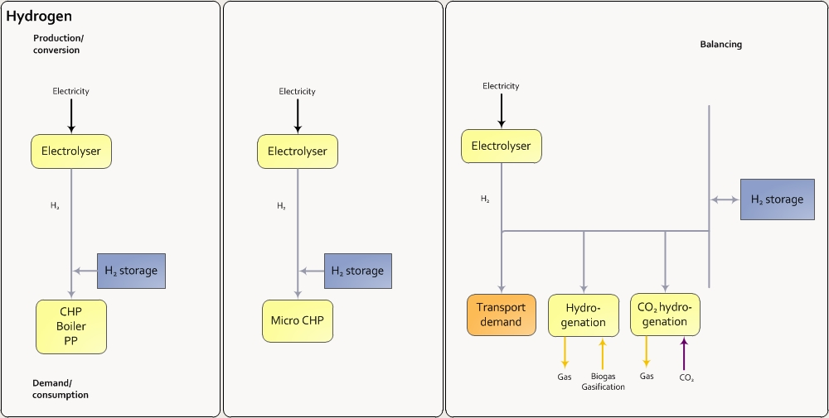
Smart Energy Systems:
Hourly modelling of all smart grids to identify synergies!
… and influence of different types of energy storage..!

Slide 11
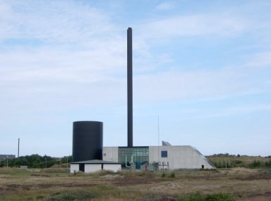
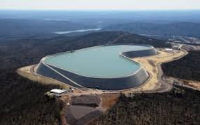
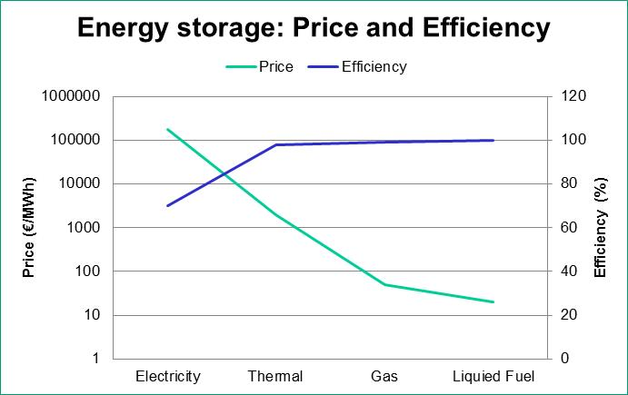
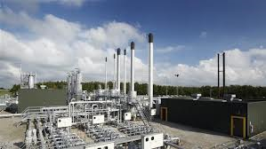
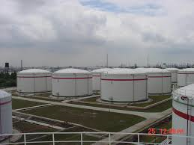
Energy Storage
Thermal Storage
1-4 €/kWh
(Source: Danish Technology Catalogue, 2012)
Pump Hydro Storage
175 €/kWh
(Source: Electricity Energy Storage Technology Options: A White Paper Primer on Applications, Costs, and Benefits. Electric Power Research Institute, 2010)
Oil Tank
0.02 €/kWh
(Source: Dahl KH, Oil tanking Copenhagen A/S, 2013: Oil Storage Tank. 2013)
Natural Gas Underground Storage
0.05 €/kWh
(Source: Current State Of and Issues Concerning Underground Natural Gas Storage. Federal Energy Regulatory Commission, 2004)

Slide 12
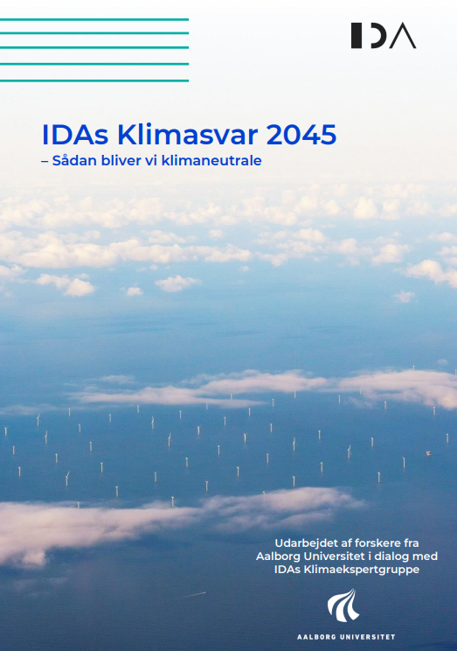
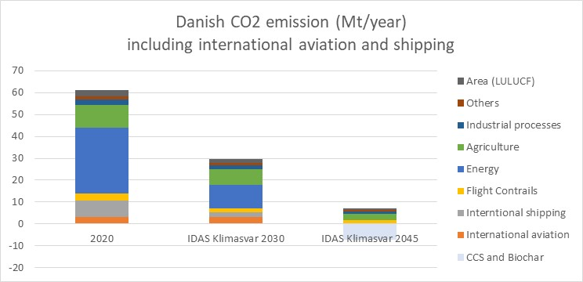
A fully decarbonized Denmark 2045

Slide 13
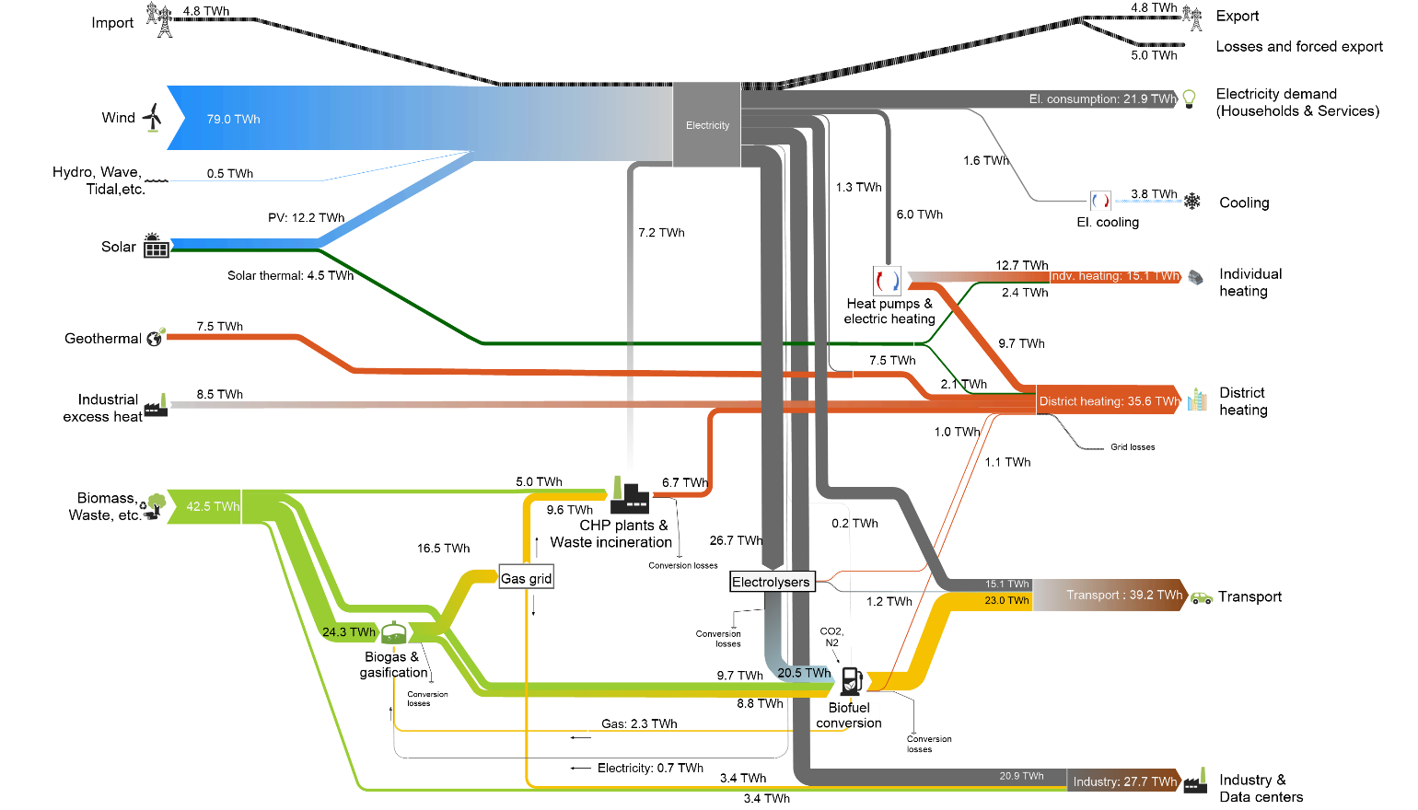
2045

Slide 14
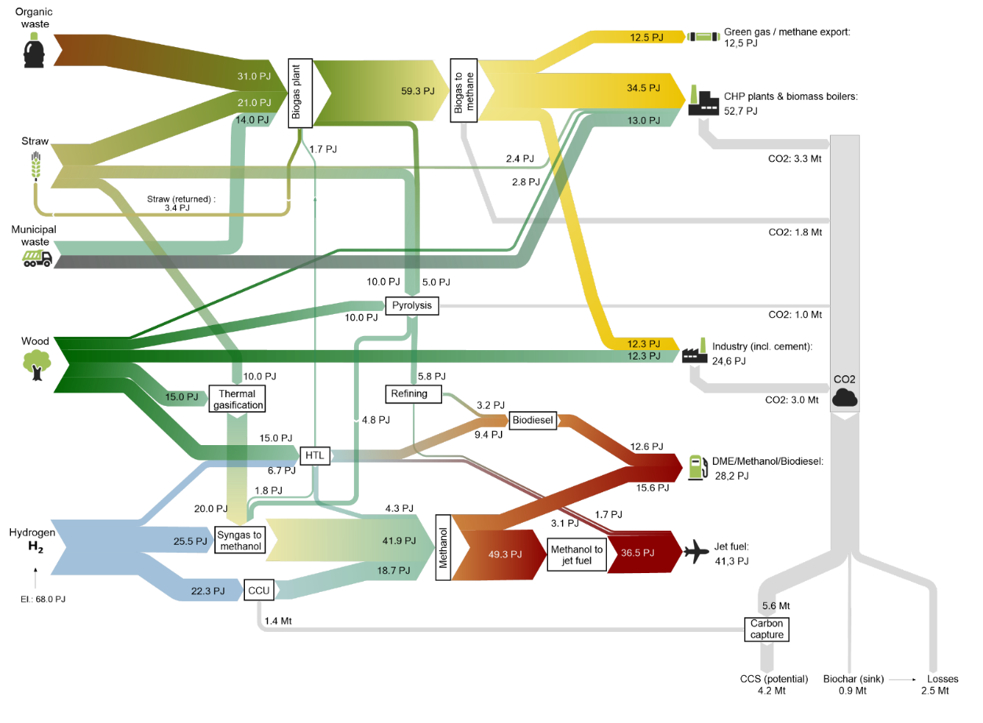
Biomasse
2045
Overview:
(153 PJ minus eksport 13 PJ = 140 PJ svarende til 23 GJ/capita)

Slide 15
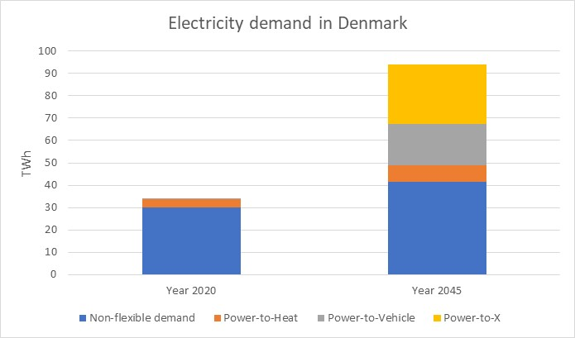
Essential changes in the future electricity demand
The ”classical” non-flexible electricity demand increases by new flexible demands for:
Electric Vehicles
Power-to-Heat (heat pumps and electrical boilers)
Electrolysis and Power-to-X

Slide 16
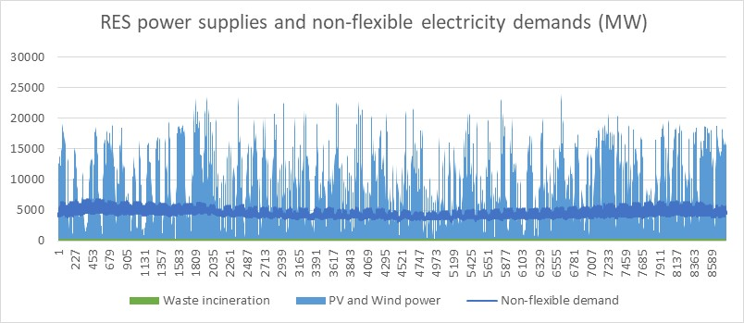
PV and wind will cover the ”classical” non-flexible electricity demand in the hour except for only 7%

Slide 17
Expansion of Solar and Wind for electricity production
MW | 2020 | 2030 | 2045
Solar (PV) | 1.000 | 5.000 | 10.000
Wind onshore | 4.200 | 4.800 | 5.000
Wind offshore | 2.000 | 6.600 | 14.000
Similar expansion of Solar Thermal and Geothermal energy for heat production

Slide 18
“Academic insights from modelling and Danish experience”
Henrik Lund, Professor in Energy Planning
Aalborg University, Denmark

