Slide 1

Power to the People:
Cooperative Energy Models for a Citizen-Led Transition
Jan De Pauw, REScoop.Vlaanderen - BELGIUM

Slide 2

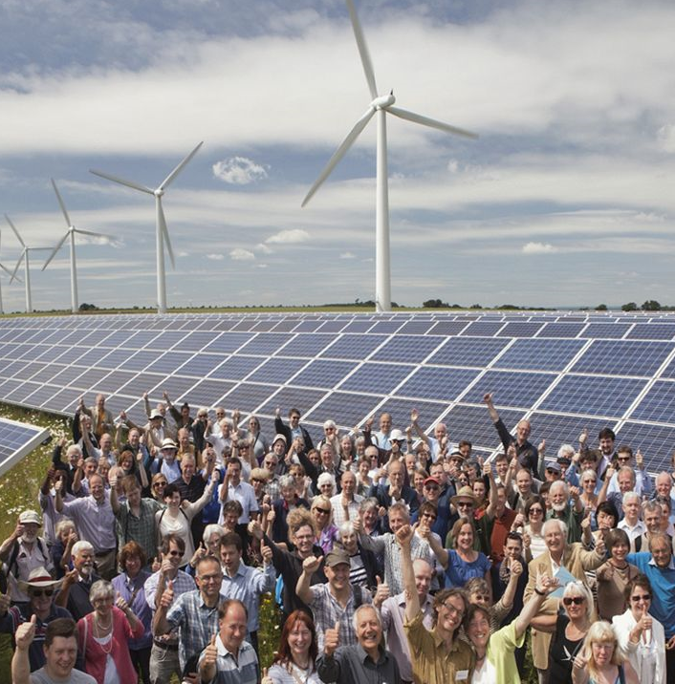
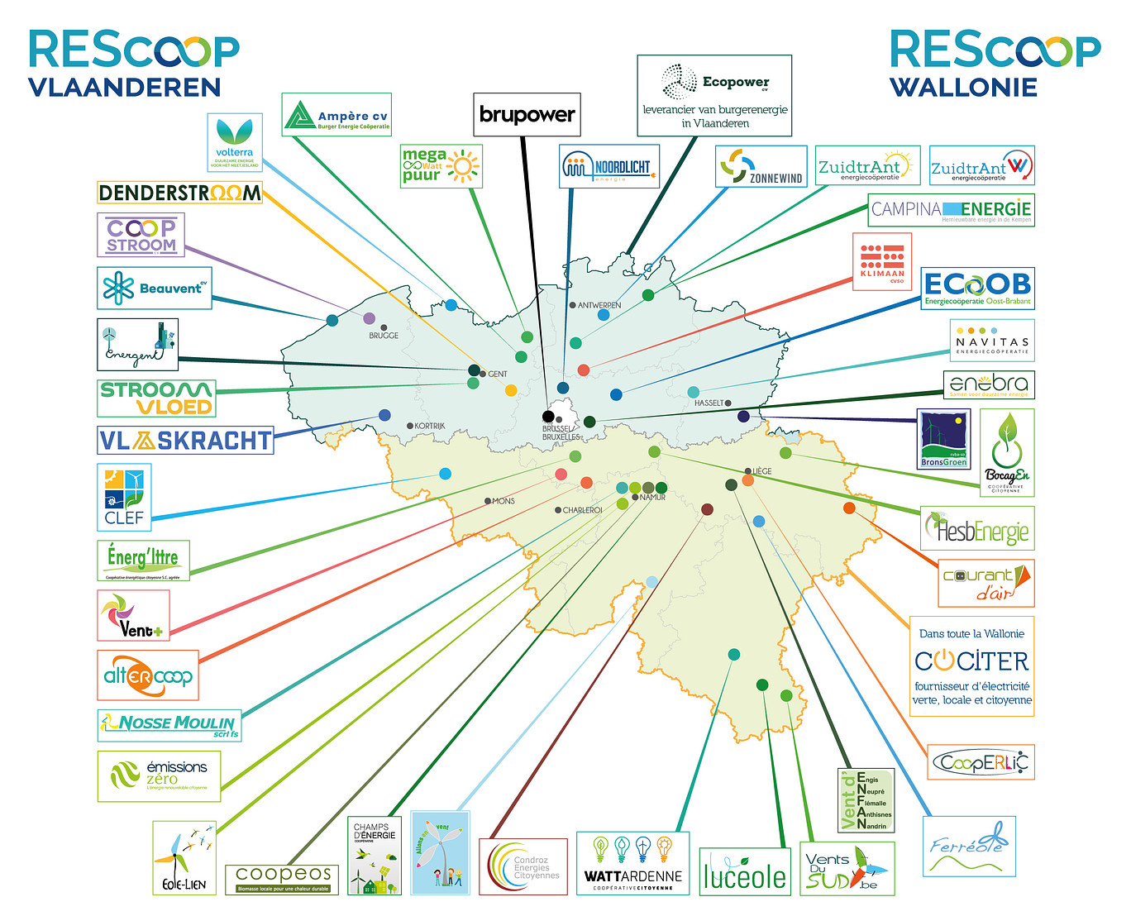
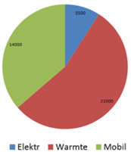

Power to the people (make-share–save)
Vlaanderen > 100.000 members > 100 MW > 100 M€ > ELEKTR-HEAT-MOBIL
Notes:
Renewable Energy Sources Cooperatives : make – share – save renewable energy together => ELEKTR-HEAT-MOBIL
BE ca 40 energy communities based on EU definitions EC (ICA-def UN : autonomy and ownerschip under democratic control)
VL ca 20 energy communities – 100,000 members – 100 MW – 100 M€

Slide 3
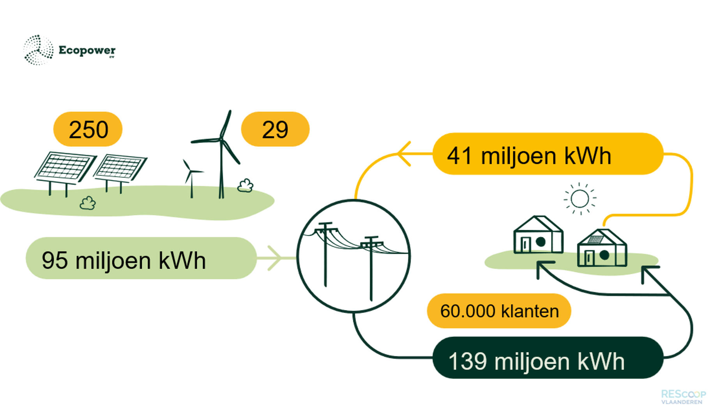
Power to the people (make-share–save)
Average household:
2000 vs 3500 kWh/year
Energy supply as a service to the members. Cociter (WAL), Enercoop (FR), Somenergia (SP)
Notes:
Electricity supply as service to the members = ca 2% of the Flemish households with topscores servicelevel and investment policy
Average households 2000 vs 3500 kWh/year
Coop suppliers: Ecopower (vl) Cociter (wal), Enercoop (fr), Somenergia (sp)

Slide 4

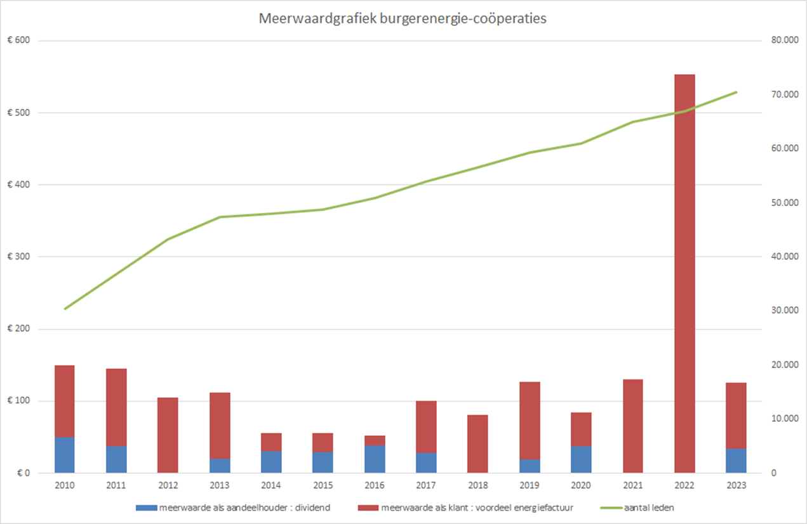
Added value energy communities
Added value
Bill > dividend
Internal solidarity
70% one share 250€
Resilience crisis 2022
90% sharing energy
Notes:
Cooperative: dubble impact members : as user on the energybill (red) > as owner on dividend (blue)
Internal solidarity EC: 70% has only 1 share 250€, 90% uses the energy at home
2022 more added value electricity bill than 30 years coop dividend

Slide 5


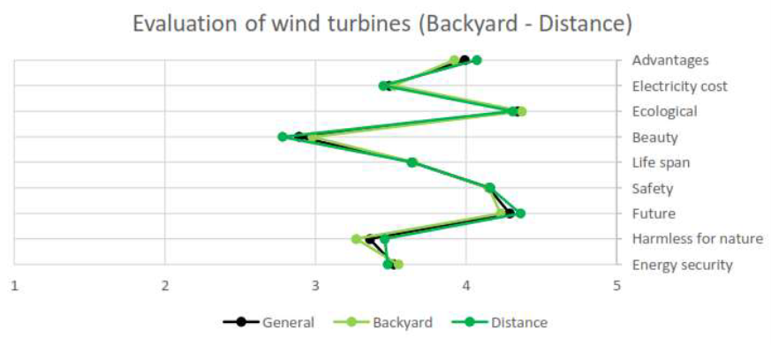
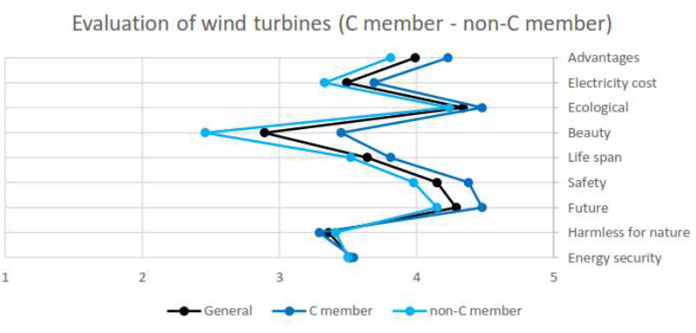
The acceptance of onshore Wind Energy in Flanders No impact line of sight (NIMBY). Big impact cooperative membership (CEC)
https://rescoopv.be/kennisbank/thesis-the-acceptance-of-onshore-wind-energy-in-flanders-ugent/
Notes:
Study Ghent university : The acceptance of onshore wind energy in Flanders (Region Eeklo: windturbines since 2000 with participation plan municipality)
No impact line of sight (no nimby), Big impact membeship EC!

Slide 6

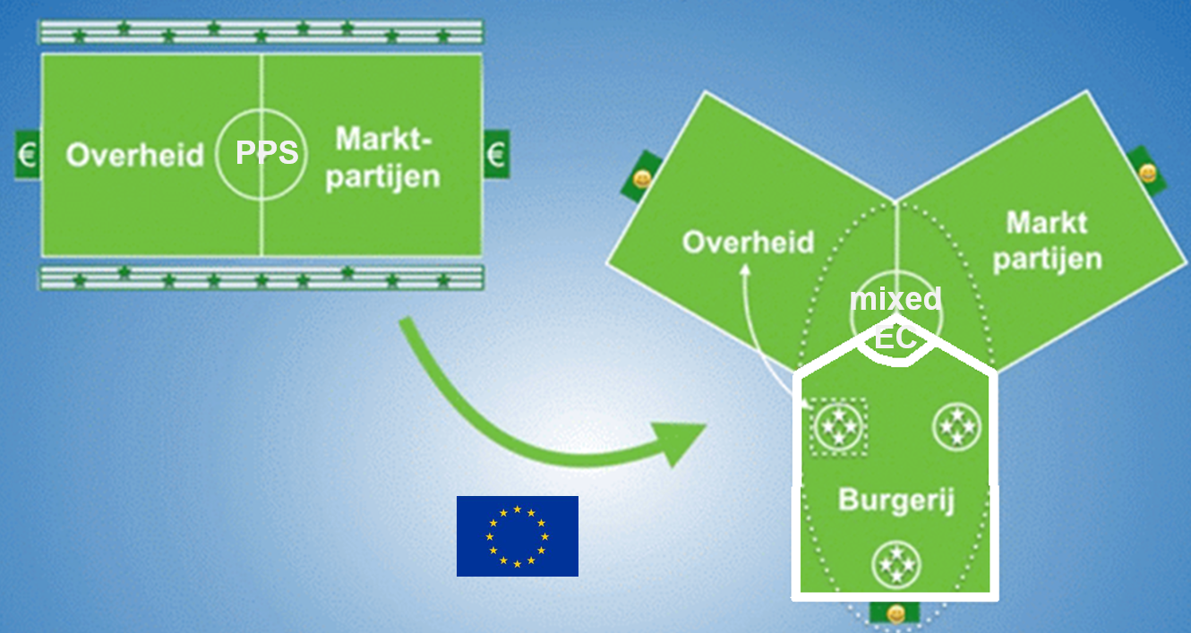


EC² : Level playing field for citizen initiatives
Notes:
2015 EC citizens at core of the european energy transition > level playing field > Citizens from passive consumer to active prosumer!
Changing the framework : citizens get their own space on the football field and can form teams to take part of the game.
Beware of corporate capture : STORY of the apple tree

Slide 7
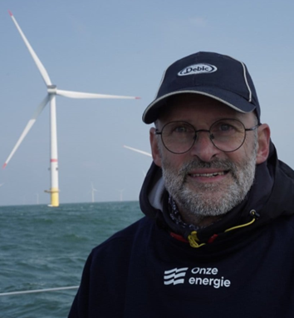



Thank you!
Presentations can be downloaded from the ESPON website after the event.

