Slide 1





Spotlights on the geography of the green industrial transition
Moderator: Marcia van der Vlugt, Dutch Ministry of the Interior and Kingdom Relations
Energy transition in Central Europe
Viktorija Dobravec, Joint Secretariat of Interreg Central Europe programme
The blue dimension of the green transition
Michaela Gensheimer, Research and Policy Manager, ESPON EGTC
Industrial transformation in Polish regions phasing out coal
Prof. Tomasz Komornicki, Polish Academy of Sciences
Geography and social inclusion of energy communities
Laura Heidecke, Principal consultant, Ecorys
Green energy for reindustrialisation in sparsely populated Nordic regions
Øyvind Vennerød, Senior manager, Menon Economics

Slide 2
Spotlight 1
Energy transition in Central Europe
Viktorija Dobravec, Joint Secretariat of Interreg Central Europe programme

Slide 3
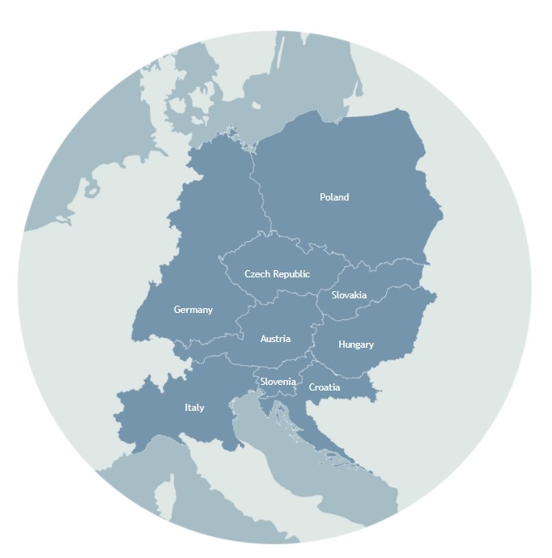
CleanEnergy4CE: Mapping the Territorial Dimension of Clean Energy Transitions in Central Europe
Central Europe, an industrial EU core, shows uneven territorial capacity and progress in clean energy transition.
Geopolitical uncertainty and the energy crisis pose risks to energy transition efforts.
Regional and local actions drive EU/national targets, but countries lack systematic information and data.

Slide 4
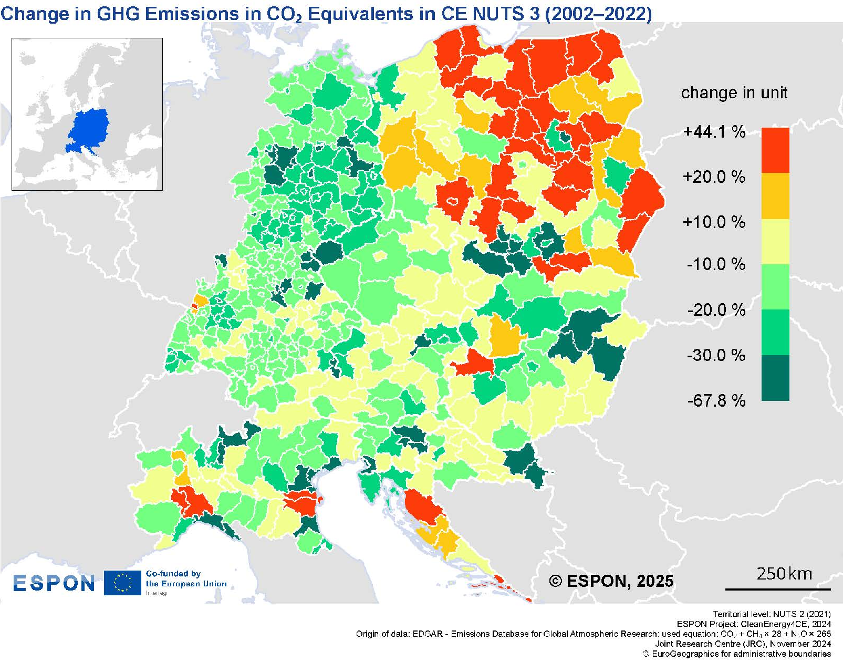
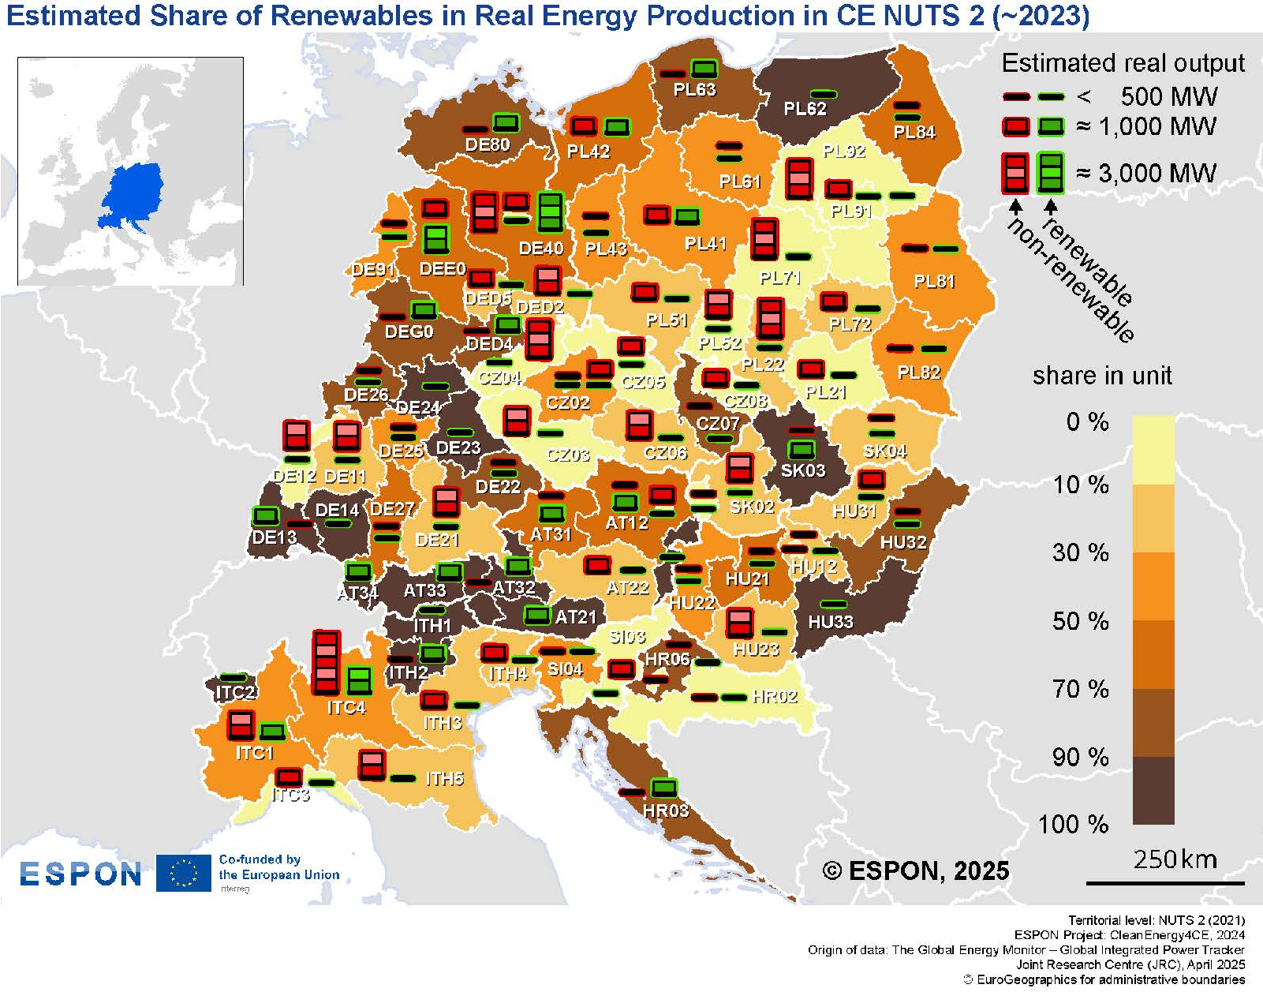
Energy transition landscape

Slide 5
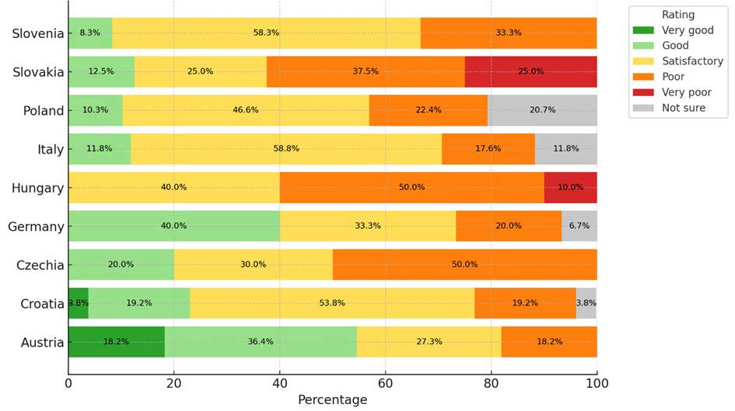
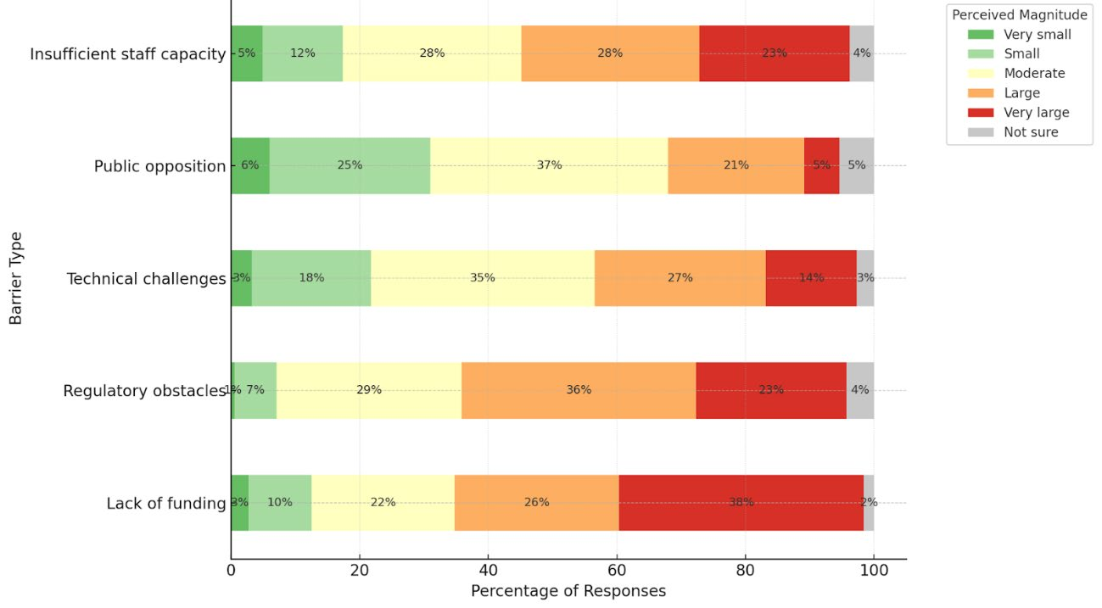
Territorial perspectives on energy transition
Perceived Progress Toward Energy Transition Goals among Respondents Reporting the Existence of a Strategy in their Area
Perceived Impact of Barriers to Energy Transition in central Europe

Slide 6
Key implications
Progress varies across regions: Some CE areas have advanced rapidly in the energy transition, while others lag behind, highlighting the need for region-specific strategies and actions.
Local and regional actors play a key role: Successful energy transition relies on active involvement of local and regional actors.
Improved data supports decision-making: Strengthening regional and local monitoring can help stakeholders better track progress and inform targeted energy transition actions.
Policy action must be place-based and coordinated: Multi-level governance, cross-border cooperation, and targeted support are key to accelerating the energy transition.

Slide 7
Spotlight 2
Industrial transformation in
Polish regions phasing out coal
Prof. Tomasz Komornicki, Polish Academy of Sciences

Slide 8
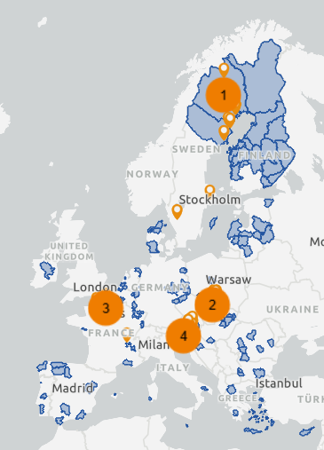
Industrial transformation in Polish regions phasing out coal
ESPON NoStaGeo
defines non-standard geographies as spaces requiring new governance models to manage the social, economic and ecological impacts of external drivers.
focuses on freshwater supply in metropolitan regions, ecological connectivity and regional and local energy-saving strategies
Cases for green Industrial transition
  Green steel in Norrbotten, SE
  Coal phasing-out in Upper Silesia and Western Małopolska, PL
  Industrial renewal along the strategic corridor Axe Seine / Vallées de la Seine et de la BresleBullet, FR
  Twin transition through microelectronics in Villach, Carinthia, AT

Slide 9
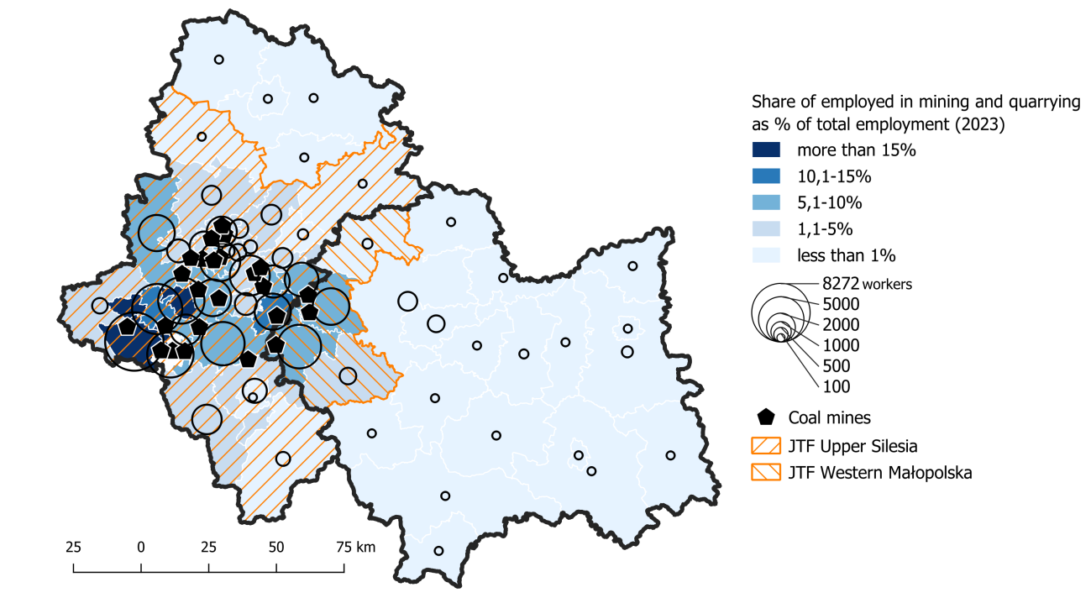
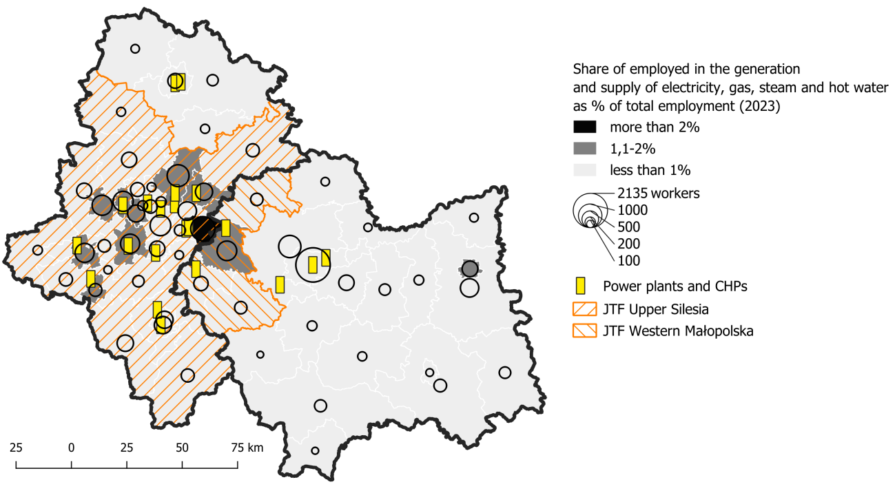
Study area
Located in Southern Poland, bordering CZ and SK
Śląskie: 12,333 km² ; population: 4.3 m (2024); GDP/capita exceeded 75% of the EU average in 2019 (PPP)
Western Małopolska: 2,046 km² ; population: 0.53 m (2024)
High degree of urbanisation and transformation of the natural environment; largest metropolitan area in PL
Traditional industrial core of PL: mining, steel, automotive, energy
Rich in natural resources, especially hard coal; the largest hard coal mining production in the EU
The Upper Silesian Metropolitan Area is the only one in Poland to have formal status. However, its area does not match that of the ITI or the JTF support area.
9

Slide 10
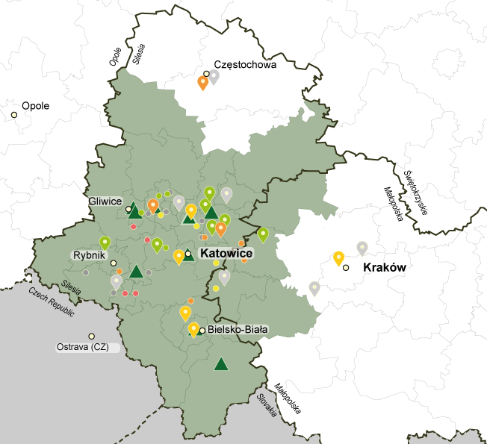



Industrial transition phasing out coal
Since the 1990s restructuring the economy
Demographic shrinkage and expanding suburbanisation
Rise in energy prices, potential loss of 82k jobs in mines and 410k in the mining-related sector, impoverishment
Substantial JTF support for the transformation
Need for training and re-skilling; 36k+ displaced workers
Impact on other areas of Poland due to power plants’ reliance on coal
Overlap with nationwide demographic trends
Intensified commuting to work
10
11/14/2025

Slide 11
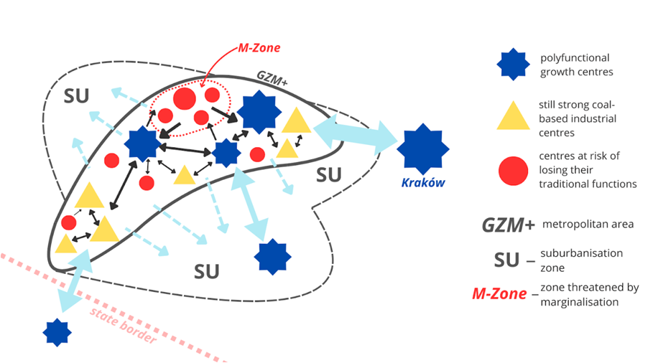
Emerging geographies
Driven by the ongoing industrial restructuring;
spatial reorganisation of functions, identities and socio-economic prospects;
Traditional industrial cores are fragmenting into a mosaic of diverging urban functions;
Shifting the epicentre of industrial activity southward, reinforcing functional ties between Silesian cities and adjacent regions;
Individual cities losing economic base; becoming similar to districts in other metropolises;
The territorial management system (strong local units, weak regions and lack of effective metropolitan structures) proved unprepared.
New spatial patterns between shrinking mining towns, industrial growth centres and affluent commuter zones underscore the need for more coherent, metropolitan-scale governance.
Leveraging multi-level cluster networks (business, research and public sector) is essential for driving coordinated, cross-sectoral innovation and ensuring a just, green, and digital industrial transition.
11/14/2025

Slide 12
Spotlight 3
Green energy for reindustrialisation in sparsely populated Nordic regions
Øyvind Vennerød, Senior manager, Menon Economics

Slide 13
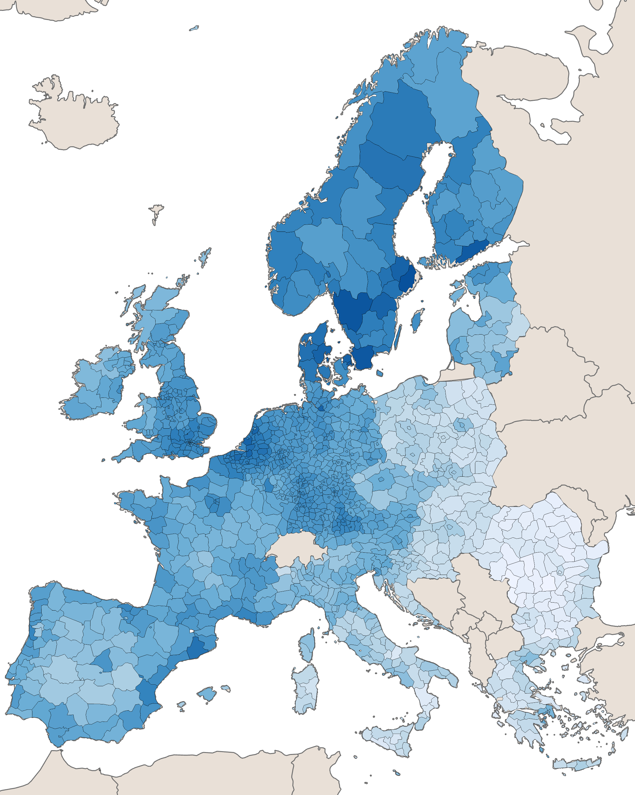
Reindustrialisation in sparsely populated Nordic regions
The Kvarken region spans three sparsely populated counties in Northern Europe, which have experienced decades of outmigration and slow growth as traditional manufacturing have declined.
The green transition offers new opportunities, but several recent industrial initiatives have failed.
The RE-Industry project aims to equip regional stakeholders with knowledge about which industries the region is best positioned to attract, the potential benefits of such establishments, and the associated risks.

Slide 14
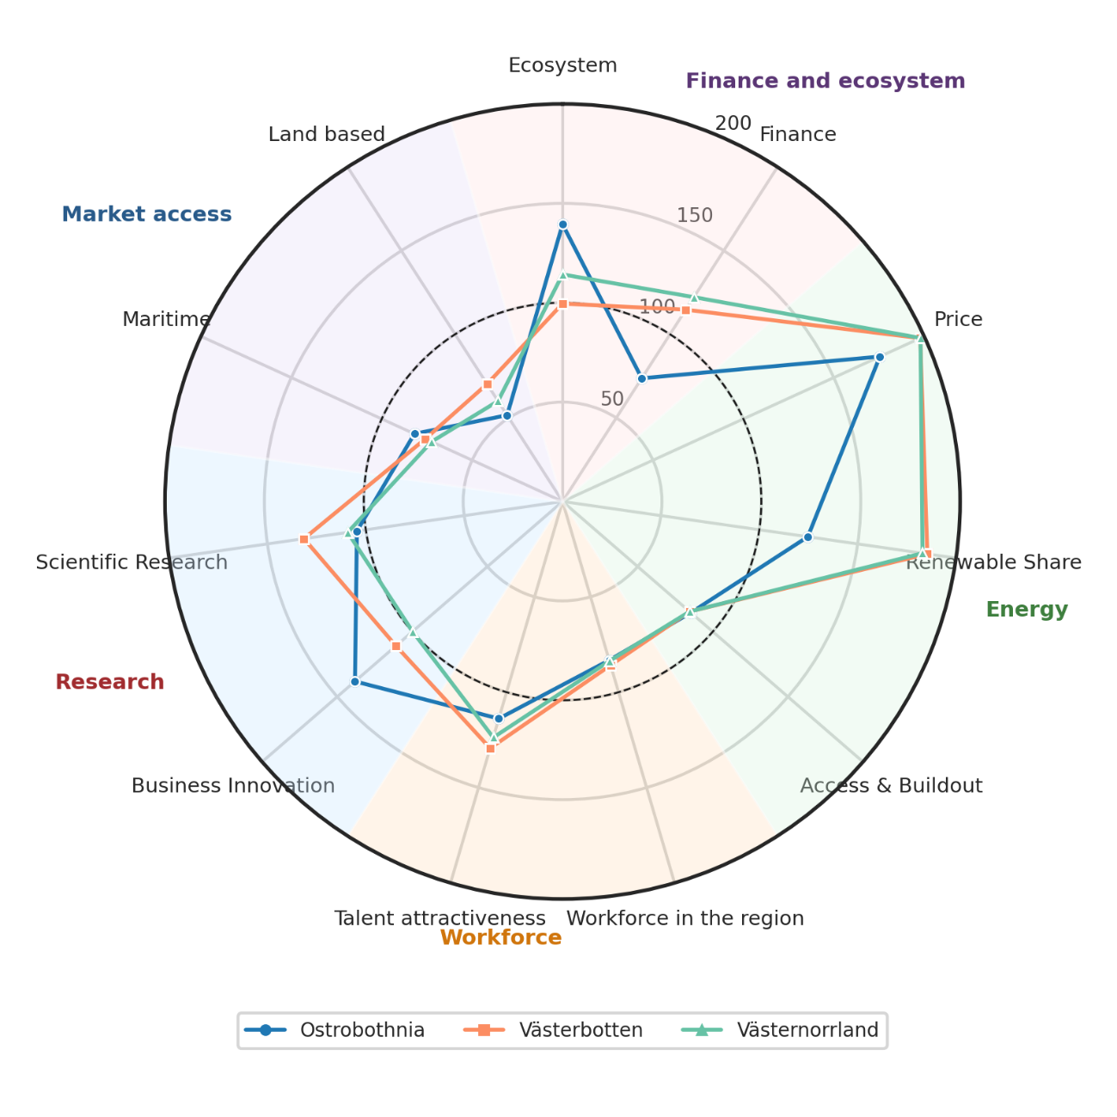
Regional competitiveness for green energy-intensive industries
Benchmarking of regional attractiveness against 1350 NUTS3 regions along five pillars:
  Energy
  Workforce and skills
  Market access
  Ecosystem and finance
  Research and innovation
Supplemented by workshops in each region and across them to identify key strengths, weaknesses and barriers.

Slide 15
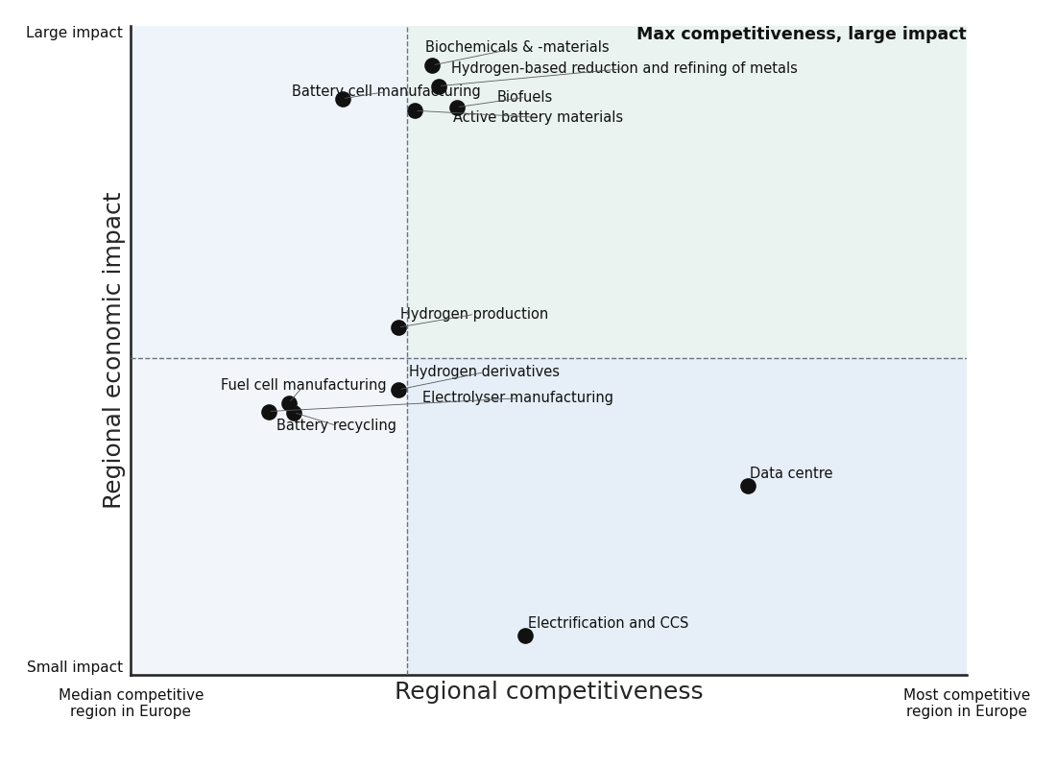
Industry-region matching for maximising benefits
Competitiveness measured by matching regional strengths with industry needs
Regional impact measured by how much the industries can contribute to
  Direct employment
  Upstream employment regionally
  Increased productivity
  Broader economic benefits (including knowledge spillovers, industrial symbiosis, vertical clusters, etc).

Slide 16

Key takeaways
If EU goals are to be achieved, they must be achieved somewhere. The Kvarken region is well-positioned.
Risk varies substantially between the industries
Benefits vary substantially across energy-intensive industries, as do required inputs.
  Regions should be explicit about what the regional goals from re-industrialisation are. What do you they truly want to achieve? What is the constraining factor?
Common challenges in the Kvarken region prevent effective scaling.
Regional costs of ambitious goals are (considered to be) large, while many of the benefits befall the national and European level.

Slide 17
Spotlight 4
The blue dimension of the green transition
Michaela Gensheimer, Research and Policy Manager, ESPON EGTC

Slide 18
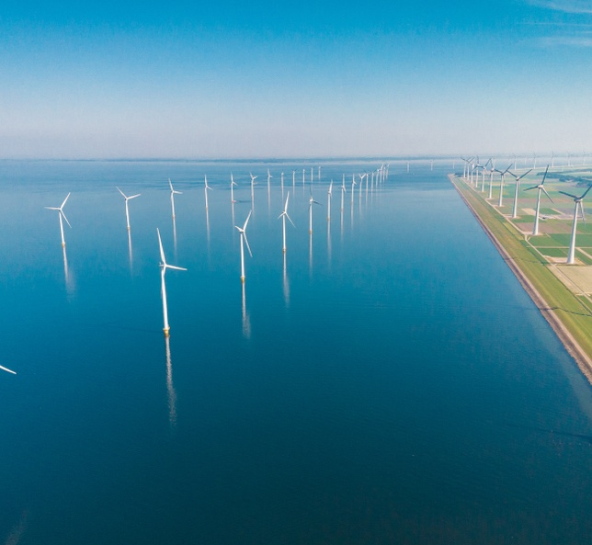
European seas as common resource for a sustainable and greener future
How can European regions and countries effectively cooperate and tackle potential sea-use conflicts to produce and provide offshore renewable energy (ORE) to reach European climate and energy goals?

Slide 19
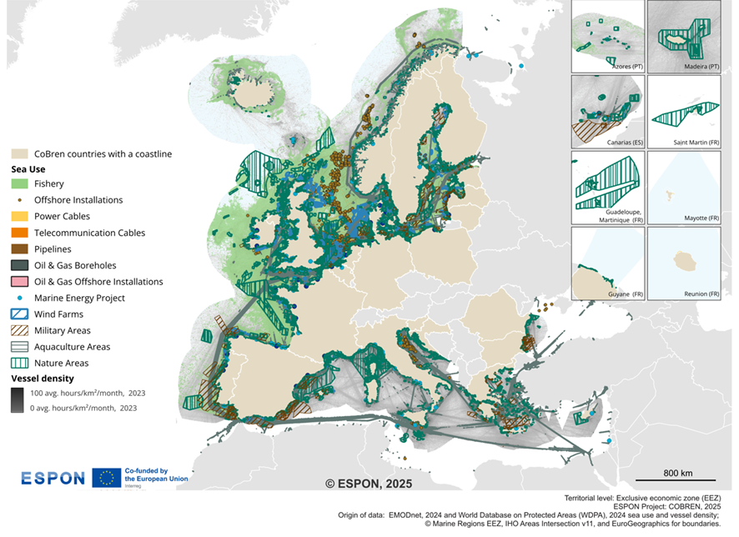

Harnessing Europe’s seas for green/blue transition
Maritime activities in European seas
European seas can play key role contributing to decarbonisation and energy security ...
but
… development pressures on marine space and coasts result in spatial saturation and increased conflict potential.

Slide 20
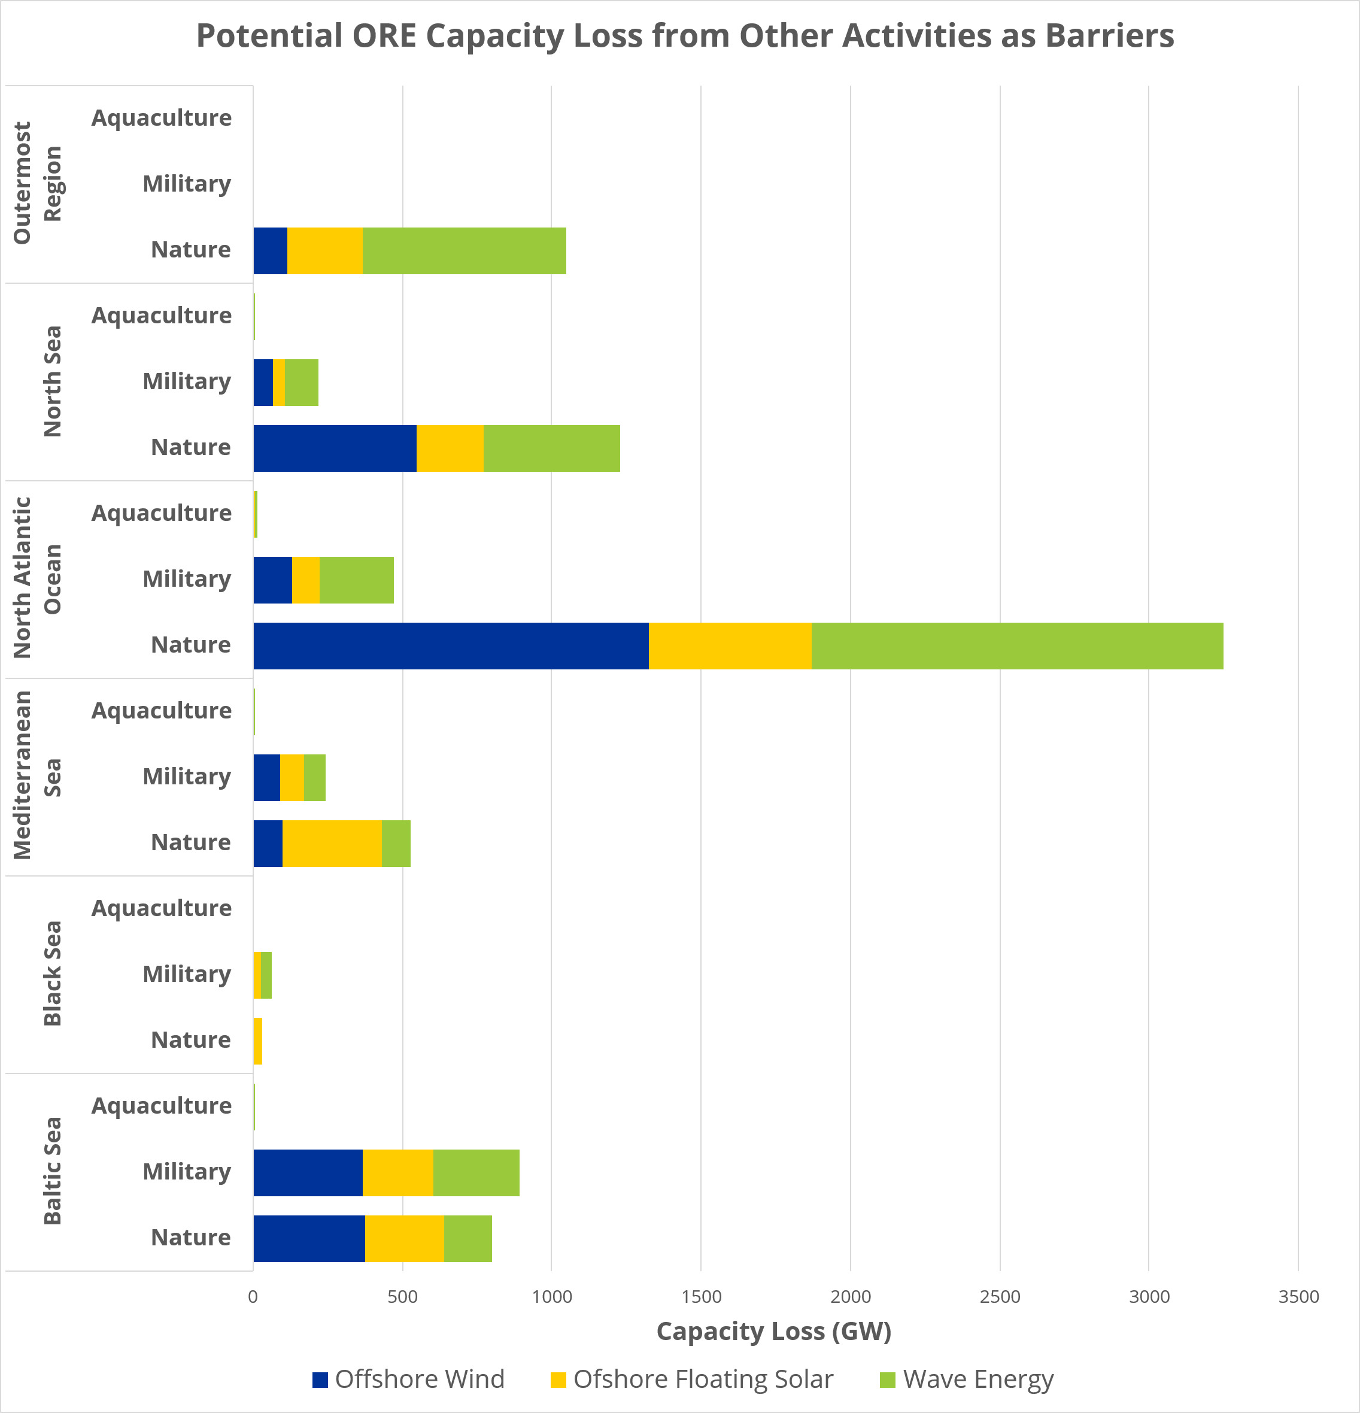
Combining ORE deployment with other sea uses
Potential ORE capacity overlaps with other sea uses, particularly nature protection and military areas:
Offshore wind capacity overlaps significantly with other ORE potential in North Atlantic, Baltic and North Seas.
Offshore solar capacity overlaps with other ORE sources in North Atlantic, Mediterranean Sea, Baltic and North Seas.
Offshore wave capacity significantly overlaps with other ORE sources particularly in North Atlantic.
CoBren

Slide 21
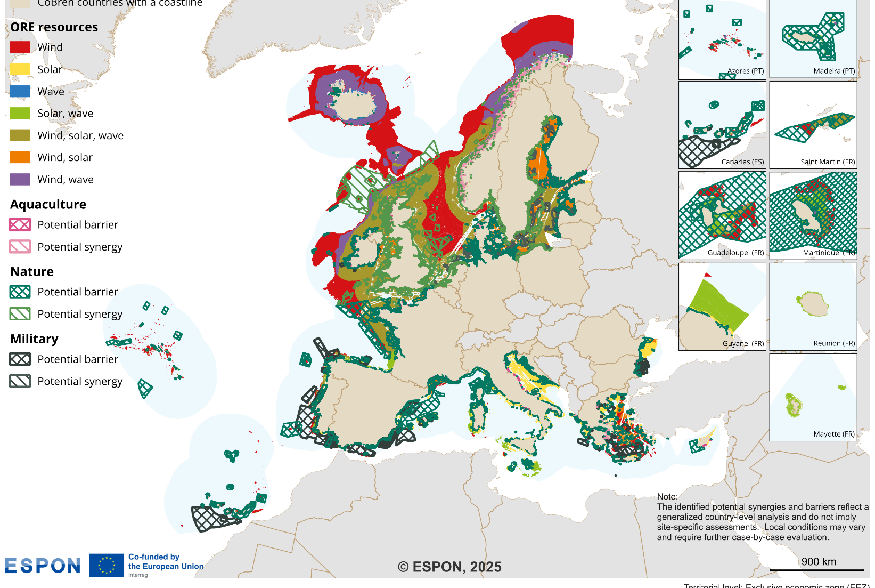
Available sea space needs to be used optimally
Potential synergies and barriers for Offshore Renewable Energy (ORE)*
To unlock the full potential of ORE, synergies and barriers with other sea use activities need to be considered.
This requires:
  integrated maritime spatial planning,
  analysis of multi-use options for maritime activities and
  transnational/sea basin cooperation.
*Note: The representation of synergies and barriers in this map is based on a qualitative, country-level analysis and is intended to provide an indicative overview of potential interactions between offshore renewable energy and other maritime uses. These classifications do not reflect detailed, site-specific assessments. Actual conditions may differ significantly depending on local context, spatial planning, and regulatory frameworks.
CoBren

Slide 22
Spotlight 5
Geography and social inclusion of energy communities
Laura Heidecke, Principal consultant, Ecorys

Slide 23
Geography and social inclusion of energy communities
Territorial Analysis of Decentralised Energy Markets [TANDEM]
Duration: October 2023 – October 2025
Implementing partners: Ecorys, Tecnalia, REScoop.eu, Energy Cities
Estimate enabling factors of energy communities
Identify and map existing energy communities
Estimate the degree of social inclusiveness
Policy recommendations

Slide 24
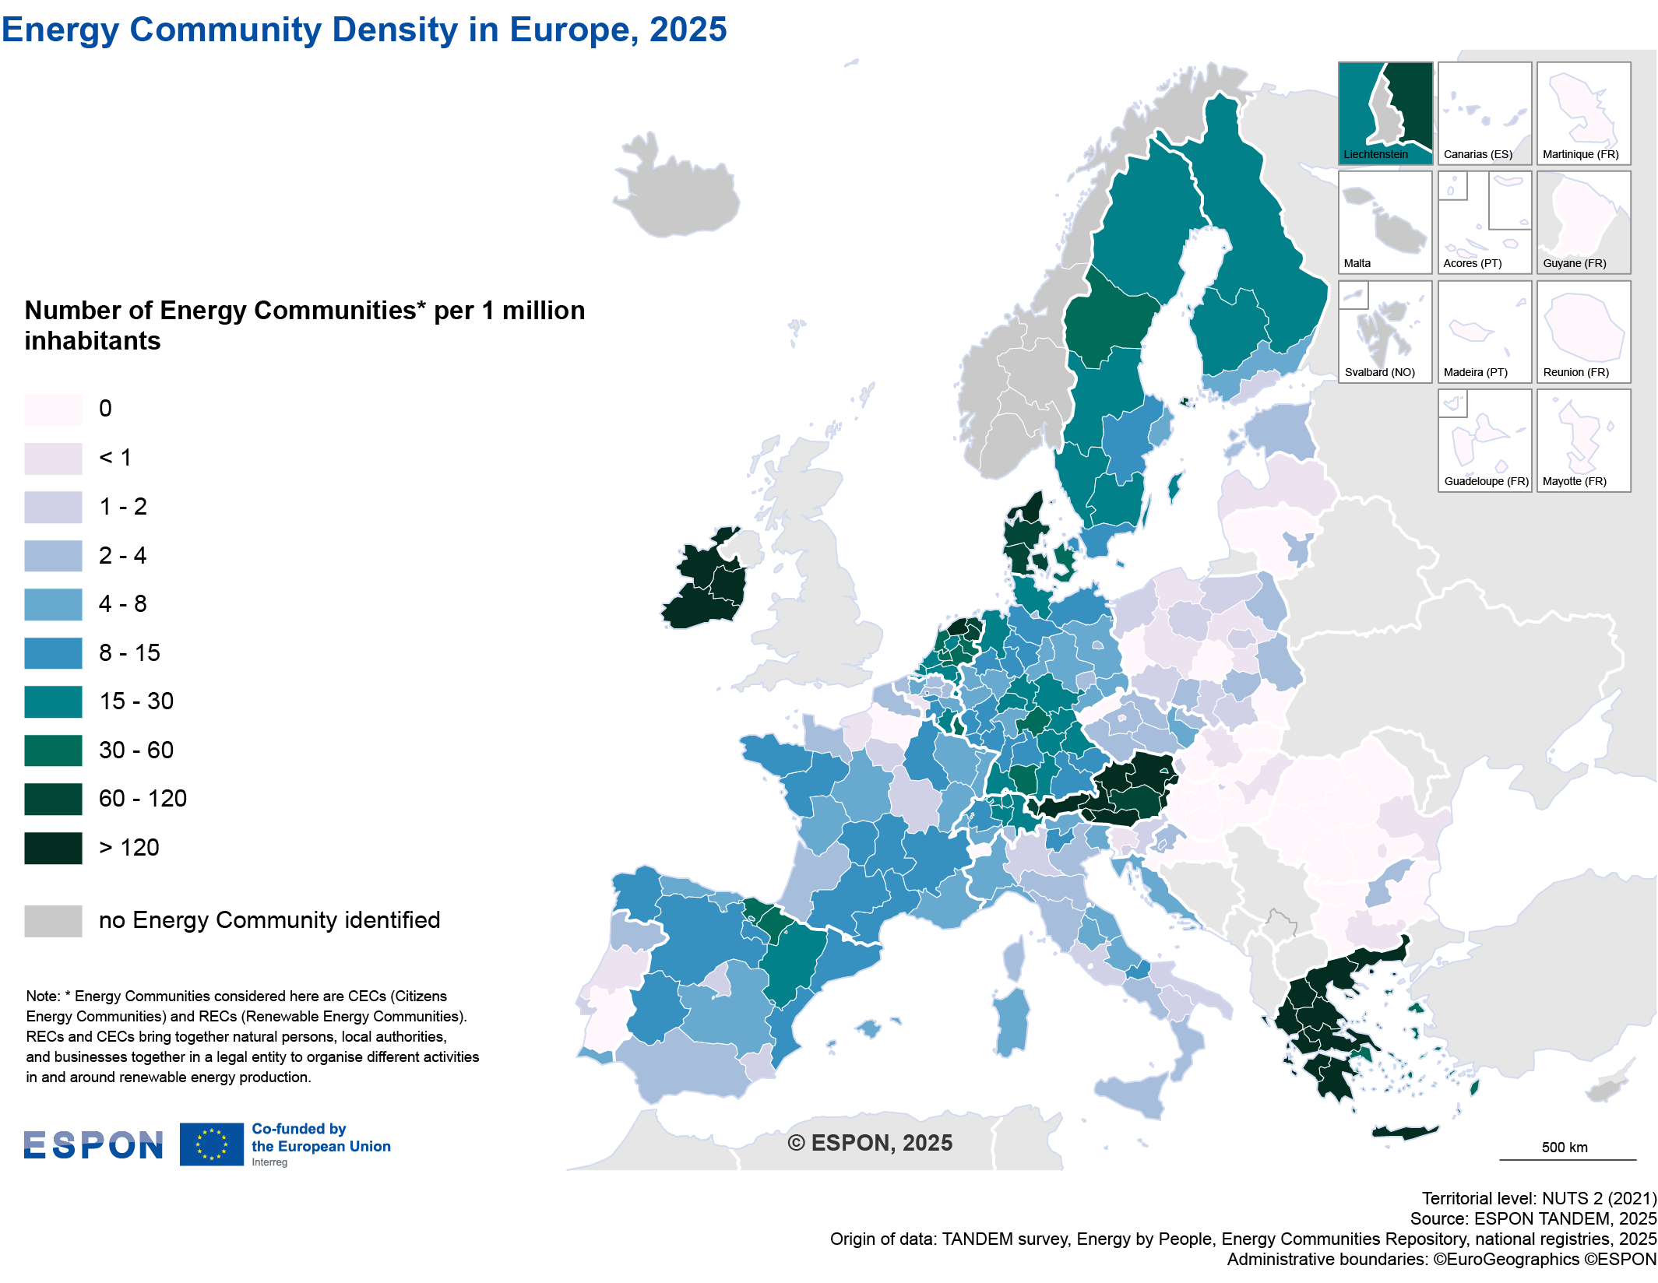
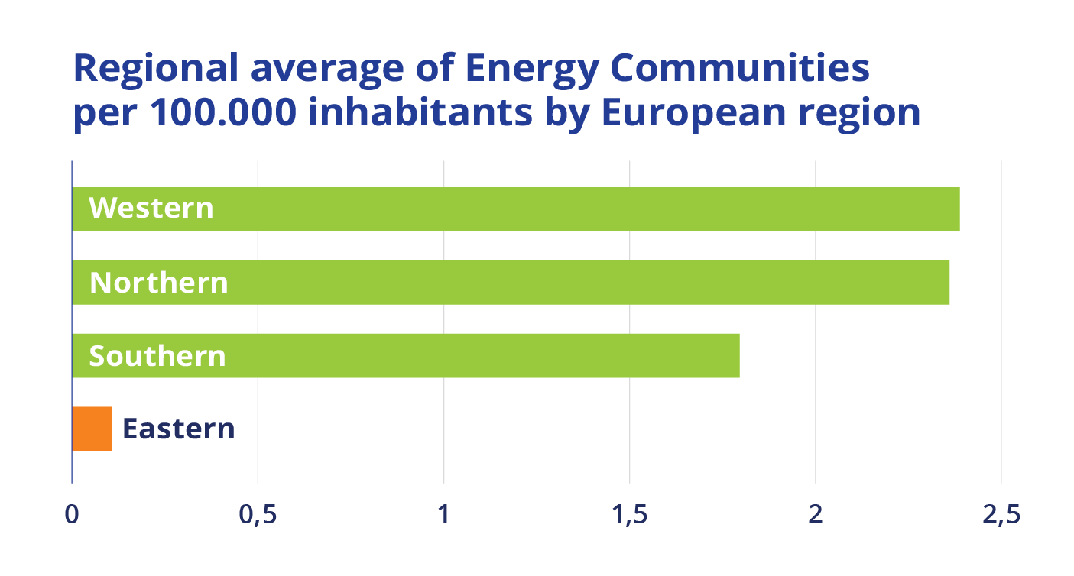
Energy Communities across Europe

Slide 25
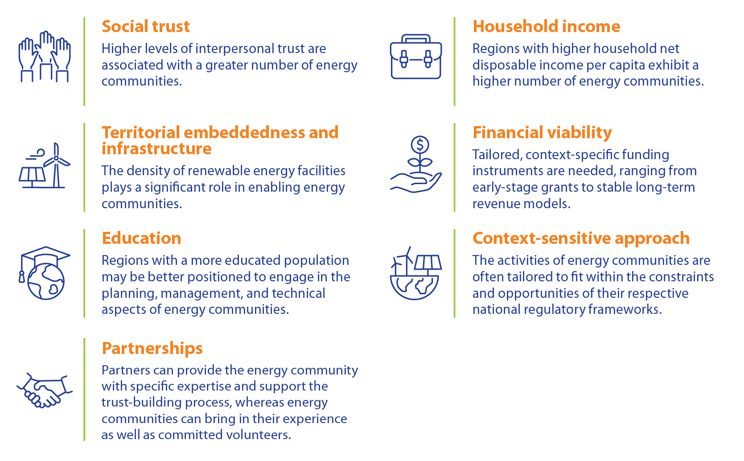
What drives development and success of Energy Communities?
Social Trust
Territorial embeddedness and infrastructure
Education
Partnerships
Household income
Financial viability
Context-sensitive approach

Slide 26
Some of our policy recommendations
Provide informational support provided to different local actors
Expand and simplify access to subsidies and financial instruments
Co-ownership/co-development models between commercial RES and energy communities
Include energy communities in mapping and planning around development of renewable energy production
Ensure a national body for registration of energy communities and that procedures are clear, transparent and simple

Slide 27
Q&A on the geography of the green industrial transition
Moderator: Marcia van der Vlugt, Dutch Ministry of the Interior and Kingdom Relations
Energy transition in Central Europe
Viktorija Dobravec, Joint Secretariat of Interreg Central Europe programme
The blue dimension of the green transition
Michaela Gensheimer, Research and Policy Manager, ESPON EGTC
Industrial transformation in Polish regions phasing out coal
Prof. Tomasz Komornicki, Polish Academy of Sciences
Geography and social inclusion of energy communities
Laura Heidecke, Principal consultant, Ecorys
Green energy for reindustrialisation in sparsely populated Nordic regions
Øyvind Vennerød, Senior manager, Menon Economics

